Slide 1
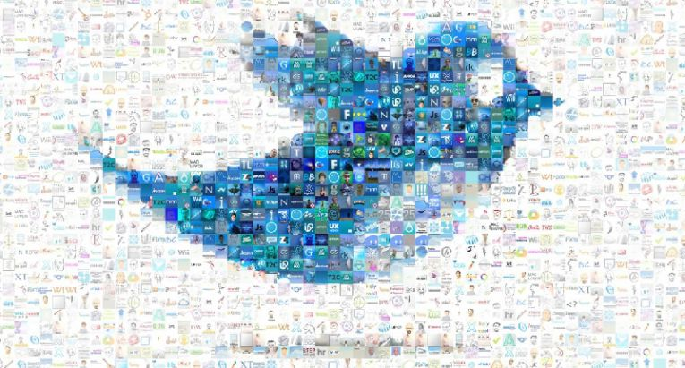
sentiment analysis OF TWEETS -#DEMONETIZATION
GROUP 01:
JIGYASA KOHLI (jk423@njit.edu)
KEKA NANDI (kn262@njit.edu)
JOHN COX (jc843@njit.edu)
SAURABH JADHAV (smj33@njit.edu)

Slide 2
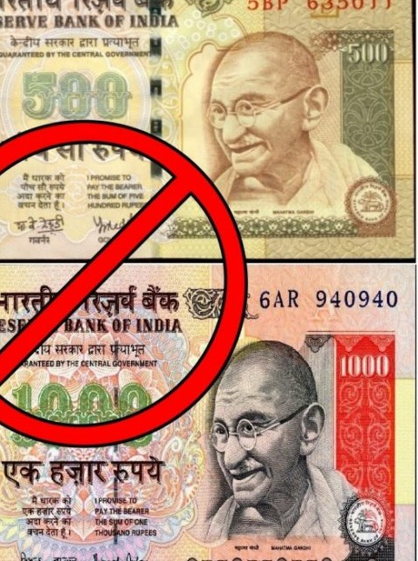
DEMONETIZATION IN INDIA
Demonetization is the absolute withdrawal of a particular form of currency from circulation.
The Demonetization started on 8th November 2016 and ended on 30th December, 2016.
The use of 500 & 1000 Rupees note was abruptly prohibited with the motive to eradicate corruption.
Was it a Good or Bad decision?
Did people support the resolution?
Let’s find out…

Slide 3

SENTIMENT ANALYSIS?
Often called as “Opinion Mining”, Sentiment Analysis is the method to let you know what people think about any topic/brand/product/etc.
It is the most efficient way of evaluating people’s expression to determine various emotions and polarity.
The most important thing in Sentiment Analysis is to review the data at defined time intervals to understand the change.

Slide 4
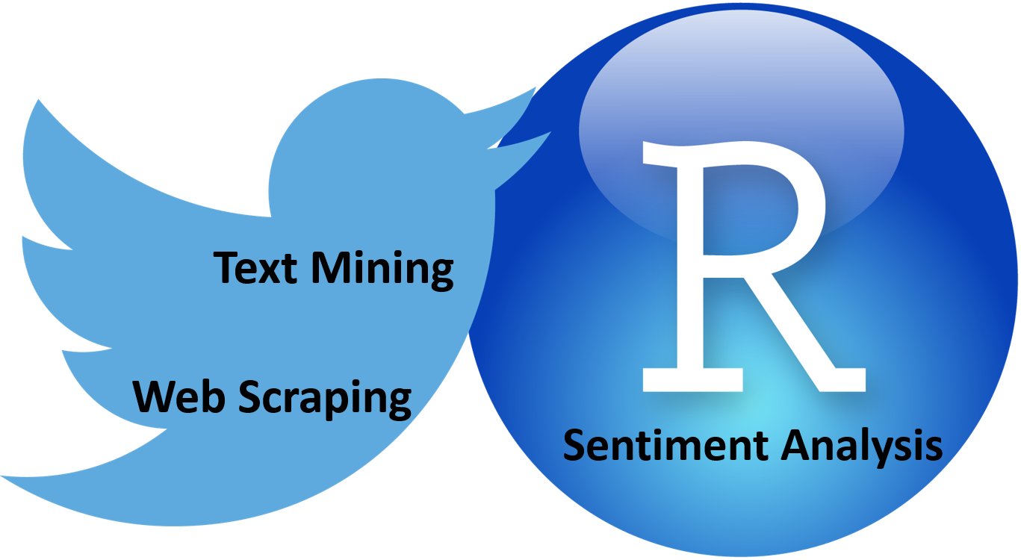
Why r for TWITTER SENTIMENT analysis?
Text analysis in R is well suited because of in-built packages and frameworks.
Better Visualization methods because sentiment analysis is all about Visualization.
R is easy to create reproducible modules with high-quality analysis.
R has inbuilt packages to deal with Twitter data like twitter.

Slide 5
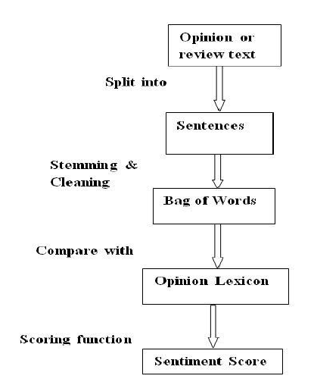
APPROACH ADOPTED
Data Extraction: Using Python Script, approximately 10,000 tweets were extracted and stored into a csv file.
Data Cleaning: Being raw data, it required cleaning which included removing NAs, html links, punctuations, blank spaces, numbers, etc.
Sentiment Analysis: Emotions (joy, sadness, fear, surprise, anger, disgust) and polarities (positive, negative and neutral) associated with the tweets were discovered.
Visualizations: To put things into perspective, this is a very necessary step. Everything derived in above step is visualized using packages like ggplot2 and word-cloud.

Slide 6
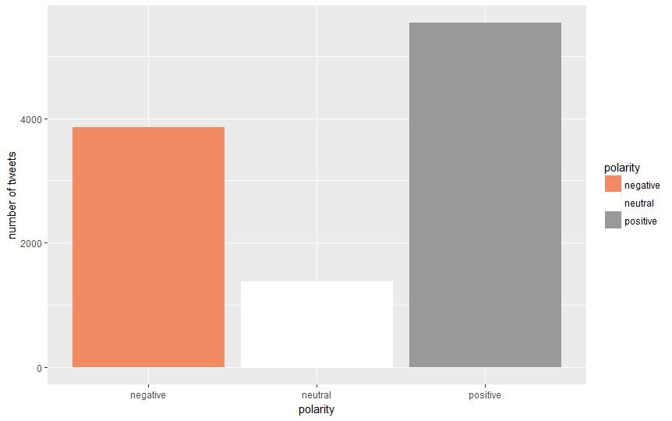
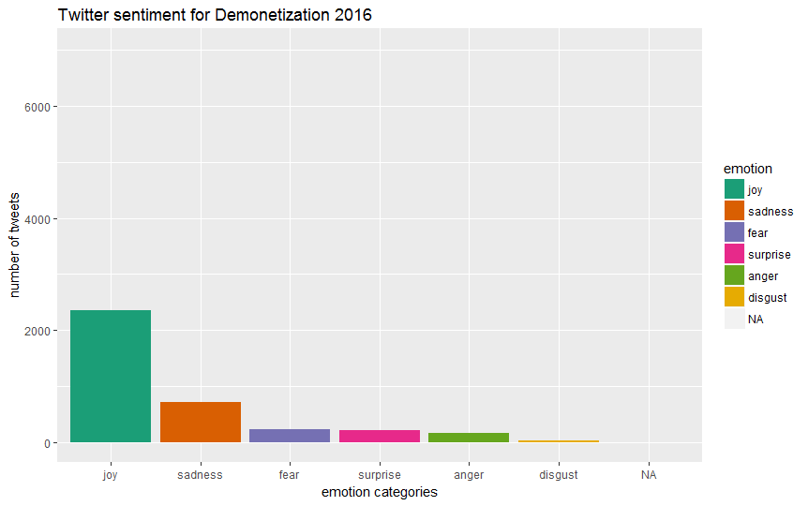
INSIGHFUL VISUALIZATIONS

Slide 7
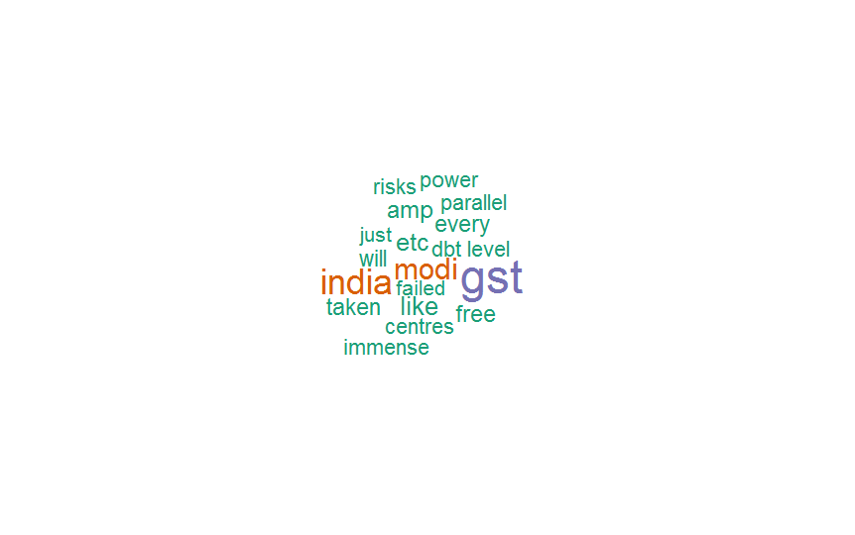
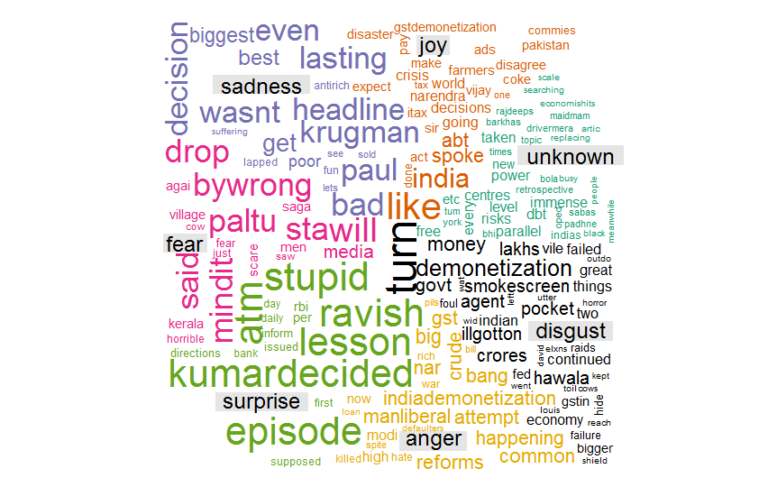
INSIGHFUL VISUALIZATIONS (CONTD.)
TOP 20 MOST USED WORDS

Slide 8

CONCLUSION
The main motive of the project was to understand the sentiment of Twitter population exclusively on the topic of Demonetization.
Majority of twitter population bolstered the Demonetization resolution.
It was a Good decision indeed.

Slide 9

CHALLENGES
All expressions cannot be strictly classified as positive, negative or neutral
Teaching a machine to understand the tone, grammatical nuances, slangs, misspellings, social media lingos is quite difficult due to its huge variations.
With large datasets, the insights gained will overshadow the concerns at granular level and the focus will be to make the results more interpretable and actionable.

Slide 10
REFERENCES
www.kaggle.com
https://en.wikipedia.org/wiki/Sentiment_analysis
https://www.lexalytics.com/technology/sentiment
https://www.brandwatch.com/blog/understanding-sentiment-analysis/

